Slide 1
AI Recruiter- Short list a suitable candidate for a specific job
Team5: Unagi
Shravan Srinivasan
Vaishali M
Kalaiarasi Natarajan
Joann Nittika
College: Sri Venkateswara College of Engineering

Slide 2
Problem Statement
AI Recruiter – Shortlist a Suitable candidate for specific Job Role:
Talent acquisition leaders say that the most difficult part of their job is to shortlist the right candidate and few of the candidates never hear back from a company after one touchpoint. On the flip side, it’s a challenge for employers to communicate well with all their candidates. For high volume recruiting, this would require communicating with thousands of candidates, in addition to a recruiter’s normal screening functions and other duties. Artificial Intelligence enabled software bots can definitely provide a solution for this problem.
Build a AI system to shortlist the candidates and conduct interviews to select the suitable candidate.

Slide 3
Proposed Solution
Through AI recruiter we are able to achieve an unbiased selection process for an industry role. Placements are made easier and more efficient to filter out the candidates who might not be able to fit the company requirements. A three module evaluation process is to be taken up by the candidate to go through the interview process. A chatbot conducts the interview and their overall performance score is calculated and the candidate will be selected or rejected based on the score.

Slide 4
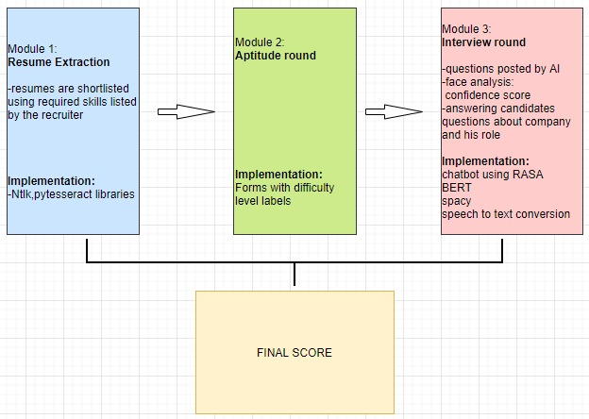
MODULE

Slide 5
Technical Stacks
The main technical stack we have used are:
Python Programming Language.
NLP – Natural Language Processing.
Speech to text Recognition.
OpenCV – Online Monitoring
Django framework

Slide 6
Module 1 – Resume shortlisting:
Used pytesseract library to convert pdf into text, and used Term frequency Inverse document method to find if the candidate is suitable for the given role.
Module 2 – Aptitude round:
The aptitude round is conducted in Google forms and the test environment is monitored automatically. Using tab proctor and web cam surveillance
Module 3 – AI-Assistant interview:
A chatbot is created using RASA in which the interview will be conducted. Technical questions will be asked to the candidate and he/she must answer using microphone. The audio is converted to text (Speech to text) and the answer is evaluated using Spacy library, checking the similarities between the correct answer and the answer given by the candidate.
Also, the candidate can ask any queries about the company or the job role to the chatbot. The chat bot will automatically answer to the queries.

Slide 7
SUGGESTIONS ?

